Slide 1
Introduction
COMP6452 Software Architecture for Blockchain Applications
Helen Paik
| Senior Lecturer @ CSE, UNSW
| Visiting Senior Research Scientist @ AAP team, CSIRO Data61
h.paik@unsw.edu.au
Dilum Bandara
| Research Scientist
| Architecture & Analytics Platforms (AAP) team
| Dilum.Bandara@data61.csiro.au
Notes:
Hello. Welcome to 2020 Term 2 offering of COMP6452, Software Architecture for Blockchain Applications.
I hope you are excited to get started.
My name is Helen Paik and I will give you a brief course overview in this video.

Slide 2
Agenda
Part 1: Course Summary
Lecturers & Tutor
Learning Outcomes, Course Outline, Assessments
Part 2: Blockchain Basics
What is Blockchain, & Why Does it Matter?
Blockchain Applications
Problem Formulation
Notes:
In part 1 of this lecture – which is this video, I will give you a course summary.
I guess we will first have to introduce ourselves, the teaching team.
Then, we will talk about the learning outcomes, course outline and assessment structure.
In part 2 of the lecture – which will be in a separate video,
Dilum – one of the lecturers from the teaching team will give you the basics of the blockchains,
going through the foundations of the technology.

Slide 3
The Team: Who’s Who at COMP6462
David Zhang
Research Scientist @ CSIRO Data61
Sherry Xu
Helen Paik
Senior Lecturer @ CSE UNSW
Research Scientist @ CSIRO Data61
Dilum Bandara
Master Student @ UNSW / CSIRO Data61
Tutor
Lecturer
Research Collaborator @ CSIRO Data61
Lecturer
Lecturer-In-Charge (LiC)
Yue Liu
PhD Student @ UNSW / CSIRO Data61
Tutor
Notes:
OK, the team. What a bunch of good looking people!
So I am Helen Paik, a senior lecturer at our school.
Although you may see my name appearing as a lecturer-in-charge in various systems at UNSW for this course,
I am involved in this course as the CSE person in charge.
The main lecturer-in-charge who is responsible for day-to-day running of the course will be
Dr. Sherry Xu who is a senior research scientist at Data61/CSIRO
We have another lecturer Dr. Dilum Bandara, who is also from Data61. He will deliver some of the lecturers, including the intro to blockchains following this video.
Then we have two highly dedicated PhD students Kuang and Kit, who will be your tutors helping you through the hands-on technical issues.

Slide 4
Australia’s Digital Innovation Powerhouse
Data61
1100+
employees
[including students]
31
Government
partners
91
Corporate
partners
38
University
partners
190+
data-driven
projects
172
patents
4 |
COMP6452 Software Architecture for Blockchain Applications | Data61, CSIRO
Notes:
As you might have noticed, the teaching team are members of the national computer science research institute called Data61 which is part of CSIRO.
Do you know what CSIRO is famous for world wide?
Out of all good things CSIRO invented, there are two things that all of you may know: Wifi and polymer bank note. The plastic bank note that we use here in Australia.

Slide 5




Overview of Blockchain Research at Data61
Supply Chain / Food Provenance
Resource handling (energy, water, land, titles)
Welfare payments
International trade
DOMAINS
Designing Trustworthy Blockchain Systems Using Smart Contracts
Architecting Blockchain applications using Model-driven development of smart contracts
Distributed Ledger Technologies
Blockchain platforms
Smart contracts
On/Off Blockchain storage
Identifying design trade-offs
Identifying Technical Risks & Opportunities
Formal & empirical evaluation of Blockchain systems
GOALS
TECHNOLOGY
OUTCOMES
Software Engineering & Architecture
Business Process Management
Cyber Security
Dependability
PRINCIPLES
Notes:
But of course what is more important to know is that the research group the current teaching team members are from is very well known for their research in blockchains.
Since the early stages of blockchain development, Data61 has been involved in research into blockchains. In particular, the research group that Sherry and Dilum are part of received a national award for contributions made to advancing blockchain technology.
Their research focused around software engineering and architecture issues in using blockchains to build systems and applications,
deeply thinking about possible design options and trade-offs in each design option.
In fact, this course aims to motivate you to think about similar issues. We want you to not only become a competent blockchain programmer,
but also a blockchain software engineer who can think through good design options and identiy pros and cons in each so that you can build a well-engineered blockchain system.

Slide 6
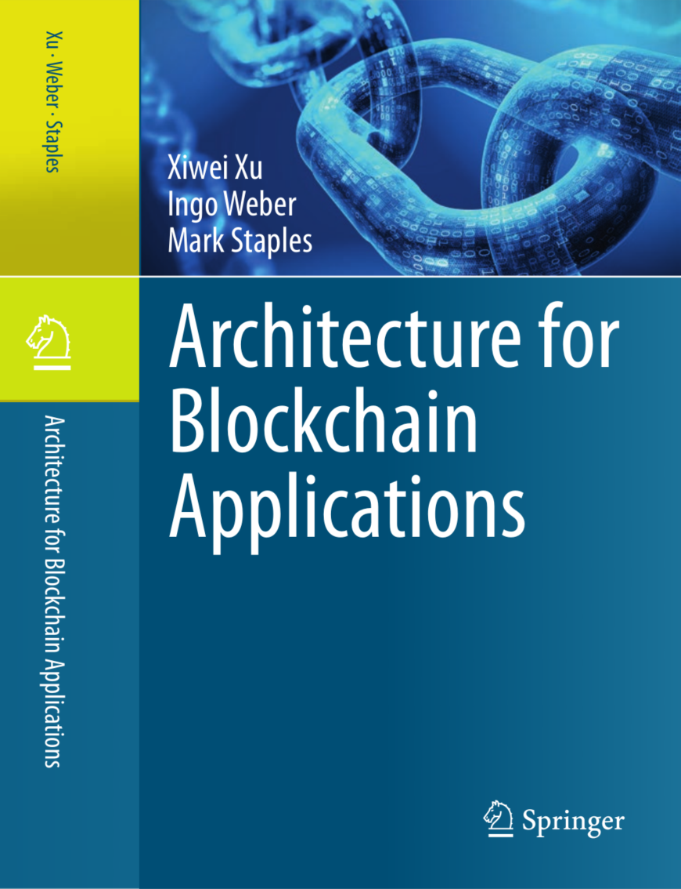
Textbook – Architecture for Blockchain Applications
Xiwei Xu, Ingo Weber, Mark Staples.
Architecture for Blockchain Applications.
Springer, 2019.
Notes:
This book discusses all the important issues of building blockchain applications from software engineering and architecture point of views.
Sherry, the lecturer-in-charge, is the lead author of the book and you will meet Dr. Mark Staples later in one of the guest lectures.
The course content closely follow the textbook. The book should be available from the UNSW library.

Slide 7
Course Structure
Notes:
OK, let’s look at briefly how the course is structured in terms of the weekly activities.

Slide 8
Learning Outcomes
After the course, you will be able to:
Develop small applications on blockchain
Explain the principles of blockchain & roles it can play in an application’s architecture
Decide on the suitability of blockchains & how to design applications on them
Make functional & non-functional trade-offs for blockchain-based applications
Notes:
First … the learning outcomes. These are what we hope you will have learned at the end of the course.
So after the course, we want you to be able to:
* develop small, but non-trivial applications on blockchains. That is, we would like you to have some hands-on skills after this course.
* we also want you to understand the principles of blockchains and explain them clearly, and the roles the technology can play in an application architecture
* You should be able to decide when blockchains are suitable in an application and how to design applications using blockchains
* Finally, you should be able to draw up pros and cons of a design in terms of functional and non-functional properties of the system and make
a decision based on the trade-offs from the analysis.

Slide 9
Course Outline (1)
 | Date | Lecturer | 1st Lecture | 2nd Lecture | Notes
1 | Jun 2 & 3 | Helen Dilum Sherry | Introduction Blockchain Basics Problem Definition | Blockchain Platforms Smart Contract Basics | Project 1 out Project 2 out
2 | Jun 9 & 10 | Sherry | Software Architecture Basics Blockchain in Software Architecture | Blockchain Taxonomy 1/2
3 | Jun 16 & 17 | Sherry | Blockchain Taxonomy 2/2 Blockchain Application Design Process | Blockchain Suitability Evaluation Laava ID project (Guest Lecture) | Project 1 submission
4 | Jun 23 & 24 | Sherry Dilum | Blockchain application patterns | Advanced patterns
5 | Jun 30 & Jul 1 | Helen Dilum Sherry | Performance | Project 2 – Presentation 1 (Use Case/Requirement/High level Design) | Project 2 – Presentation 1
Notes:
Now let's look at the weekly schedule of the course in terms of the topics and assignment activities.
Week 1, this week, after the course intro, you will learn the basics of blockchains and the various problems you need to understand in applying blockchain technology.
You will also learn the different blockchain platforms available currently and the basics of smart contracts – the programming paradigm that everybody uses to build applications on blockchains.
Actually this smart contract topic will be the core of your first project. You will be guided through how to write your first smart contract, how to make it run on a blockchain – then we will give you a little extra activities you need to complete.
As I mentioned, the course discusses a lot of software architecture related topics, so in Week 2, we will introduce some basics of the software architecture area and related concepts, then we will talk about software architecture topics in the context of blockchains. This will lead into showing you the design taxonomy of blockchain-based architectures. The taxonomy basically will allow you to breakdown
the design choice issues into different categories and available options. Having something like this allows you to evaluate and compare different design choices clearly.
The taxonomy topic flows onto Week 3 and then we will talk about how you might use the taxonomy to design a blockchain-based application (the thought process). And also how you may decide if blockchain technology suitable for given situations or not. In the second lecture in Week 3, we will have a guest speaker showing you an industry project example that utilised blockchains so you could see a real use case.
In Week 3, we will also release the second project – which will be a group activity. The details of the second project will be released in due course, but the main idea is for you to build a non-trivial blockchain application from scratch, applying the design concepts you have learned in the course. There will be two check points for this project, the first one, you need to show us your design and requirement analysis of your application, then in the final check point, you will be presenting the complete working application to us.
In Week 4, to further go into the design concepts and methodology in blockchain applications, we will discuss design patterns. Design patterns in software engineering is introduced to provide a good solution to recurring or common problems in software development. We will show you some application design patterns that involves blockchains and what sort of problems they tackle. Hopefully you will be able to identify some of them in your own projects.
In Week 5, we will talk about the performance of blockchain-based systems, general issues and how to, what to measure when we talk about performance issues in blockchains. In the second lecture in that week, we will ask you to present your project 2 design solution to us.

Slide 10
Course Outline (2)
 | Date | Lecturer | 1st Lecture | 2nd Lecture | Notes
6 | Break
7 | Jul 14 & 15 | Dilum | Smart contract testing | Security Reliability
8 | Jul 21 & 22 | Helen | Model-driven engineering | Privacy Data Governance Data Management
9 | Jul 28 & 29 | Helen Dilum Sherry | Cost Guest lecture | Project 2 – Presentation 2 | Presentation 2 (Demo)
10 | Aug4 & 5 | Sherry | Guest lecture | Summary Sample Questions | Project 2 submission
Course website: https://moodle.telt.unsw.edu.au/course/view.php?id=60211
Notes:
Week 6 is a quiet week – so you can catch up with stuff.
Week 7, we will talk about testing smart contracts, again things to consider when testing smart contracts, how to test, etc.
After the testing, mostly the topics moves onto what we call non-functional properties of software, topics like security, reliability, privacy, etc.
In Week 9, in the second part of the lecture, we will ask you to present the final outcome of your project to us.
There will be a couple of more guest lecturers introducing some real-world use cases of blockchains.
In the final week, we will summarise the course and give you some sample questions for the final exam.

Slide 11
Assessments
Assessment Title | Assessment Type | Marks
Projects (2) | Assignment | 15 + 30
 | 2 assignments where you will analyse & implement blockchain scenarios using smart contracts
Quizzes (5) | Quiz Test | 10 x 2 = 20
 | 2 online quizzes on material covered up to that point
Final Exam | Examination | 35
 | A written take home examination, testing all course content Students must obtain a passing grade on the exam to pass the course (i.e., < 50% of the exam points means failing the course)

Slide 12
Blockchain Basics

Slide 13

Goal – Decentralized Trustless Environment
Organization 1
Organization 2
Organization 1
Organization 2
Centralized Trusted Authority
Blockchain network
Traditional trusted environment
Blockchain trustless environment
Notes:
one thing.
Which is its goal to "replace a central trusted authority with a network of computers".
While central trusted parties such as banks, regulatory bodies, and government are essential to establish trust between 2 transacting parties, they are many concerns around them.
For example,
They have the power to control and manipulate the system
Lead to a single point of failure
Their internal system state is opaque to the participants
They are fragmented making it difficult to interoperate and collaborate
Also, it leads to high costs
When it comes to the BC network, we don't trust any single computer but trust their collective behaviour
We ensure correct collective behaviour by
Replicating the state across many nodes in the network
Ensure all nodes agree on what changes are made to the state, and by whom
Making state public
Also, incentives maybe given to nodes to ensure the majority behave correctly

Slide 14

Solution – Blockchain
Genesis Block
H( )
H(Previous block)
H(Previous block)
H(Previous block)
Transactions
⁞
Transactions
⁞
Transactions
⁞
Linked list with hash pointers
Notes:
From a data structure perspective, BC is essentially a linked list distributed across a network of nodes
Each element in the list is called a block. Hence, we call this "chain of blocks" a "blockchain"
Each block has a header and payload.
Payload consists of a set of Transactions (TXs).
The header consists of a summary derived from the payload and a pointer to the hash pf the previous block in the chain.
Which in turn reflects its own payload and a pointer to the previous block.
The very 1st block is referred to as the genesis block.

Slide 15
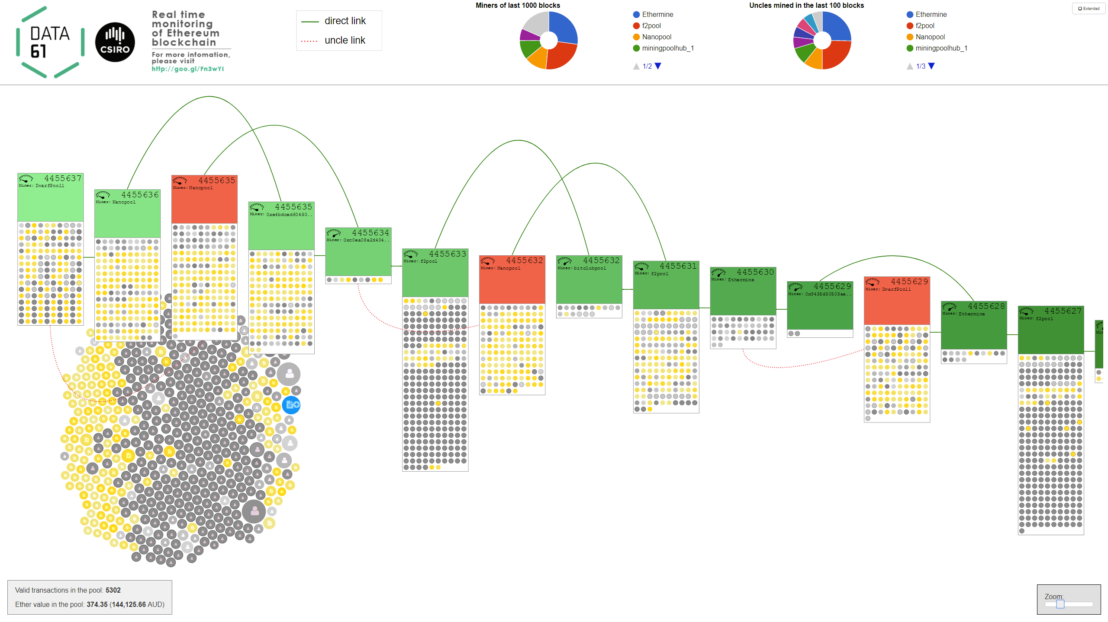
Visualization of a Blockchain – http://ethviewer.live
15 |
COMP6452 Software Architecture for Blockchain Applications | Data61, CSIRO
Notes:
http://www.ethviewer.live/
This is a live visualisation of the Ethereum BC developed by our team.
You can access it from http://ethviewer.live
These are a set of TXs pending to be included in a block. You could consider these as someone paying someone else. Size of a circle indicates the value of a TX in a cryptocurrency called Ether
Grey ones are cryptocurrency TXs, while others are related to Smart Contracts (SCs).
If you click on one of these, we can see the details at Etherescan.io which is like a search engine for Ethereum TXs.
These are the set of blocks and TXs included in them
Typically every 13-15 sec a new block is built, and it points to a parent.
Process of creating a block is called mining
While a box has a maximum capacity, miner may decide to build a block with a fewer set of TXs
Sometimes there can be conflicts. For examples, these red blocks don't have any successors; hence, eventually, be discarded. TXs in these blocks are discarded and they go back to the TX pool to be included in a future block.
We could relate this behaviour to a ledger used in accounting.
For e.g., each block is like a page on the ledger that you record TXs.
Once the page is full, we summarise the balance and carry the balance to the next page.
In BCs, we maintain the ledger using a distributed set of nodes where each node maintains a copy of the ledger.
Suppose you want to change a TX as you want to double spend your money or want to hide a fraudulent TX
So if you change or delete your TX, it will change the block header. Consequently, the successor block is no longer valid as it points to the updated block. Hence, you need to change that too. Which in turn, mean all the blocks up to the latest block need to be rebuilt.
Usually, you need to perform some work to mine a block, for e.g., here it says it took 4 seconds to build a block.
Hence, it becomes increasingly difficult for a single node or a small subset of nodes to alter a bad block and all other blocks that follows while the honest nodes continue to build more blocks.
Thus, the "chain of blocks" is so interconnected that it becomes computationally difficulty to tamper it.

Slide 16
What is Blockchain, & Why Does it Matter?
Immutable public ledger
Replicated ledger → Transparency & High Availability
Timestamped & signed transactions → Consistently & Integrity
Audit trail of what happened → Auditability
Based on Public-Key Cryptography & Hashing
Address many distributed system problems
Timing & Ordering
Consensus
CAP Theorem
Notes:
So BC can be considered as an immutable public ledger with a set of properties
As the blocks are replicated - anyone can access them leading to high transparency & availability
Block are also time-stamped and TXs are signed - leading to a consistent state across all nodes where it is computationally infeasible to compromise its integrity
Immutability and transparency leave an audit trail of TXs and their results
Underneath BCs rely on Public-Key Cryptography and Hashing
It's also built around many aspects of distributed computing while addressing classical problems like timing and ordering of events, consensus among many nodes, and CAP Theorem which we'll learn shortly

Slide 17
Transaction (TX)
To:
From:
Value / Data:
Sender’s Signature:
Identifiable data package
Monetary value (Cryptocurrency)
Code
Parameters/results of function calls
Input:
Previous tx: f5d8ee39a430901c91a5917b9f2dc19d6d1a0e9cea205b009ca73dd04470b9a6
Index: 0
scriptSig: 304502206e21798a42fae0e854281abd38bacd1aeed3ee3738d9e1446618c4571d10
90db022100e2ac980643b0b82c0e88ffdfec6b64e3e6ba35e7ba5fdd7d5d6cc8d25c6b241501
Output:
Value: 5000000000
scriptPubKey: OP_DUP OP_HASH160 404371705fa9bd789a2fcd52d2c580b65d35549d
OP_EQUALVERIFY OP_CHECKSIG
Notes:
As I just showed you on Etherescan a TX is an identifiable data package or a unit of operation
Depending on the BC platform, it may consist of a monetary value, SC code, or parameters/results of SC function calls
Some of the fields in a TX such as to, from, and signature are compulsory
This is an example from Bitcoin, which define a set of input and outputs

Slide 18
Blockchain Formation
H( )
Genesis Block
H(Previous block)
H(Previous block)
H(Previous block)
Transactions
⁞
Transactions
⁞
Transactions
⁞
Collection of ordered TXs form a block
Collection of blocks form a blockchain
Blocks are build by distributed set of nodes
Nodes agree on contents of a block, order of blocks, & who has the right to build a block → Consistent chain of blocks
Notes:
To summarise, a collection of ordered TXs form a block. And the process of building a block is called mining
Collection of blocks form a BC
The nodes in the BC network agree on contents of a block, order of blocks, and who has the right to build a block

Slide 19



Blockchain Network
P2P network of nodes
Has same rights to manipulate data
Every node hosts a replica
High availability
Efficient reading
Communication
Gossip protocol for TX propagation
Consensus protocol for agreement
Notes:
Let's talk a bit about the BC network
It's essentially a peer-to-peer (P2P) network where all participants have the same rights to store and manipulate data
Because there are so many nodes and copies of the ledger, we can achieve high-availability and fast reading.
TXs are propagated among P2P nodes based on a gossip protocol. It's not very different to gossiping in real-world where a friend tells you some gossip, and you tell it to someone else. Eventually, it's no longer a gossip and everyone knows it except a few colleges
Further, nodes use a consensus protocol to agree on what changes are to be made and by whom

Slide 20

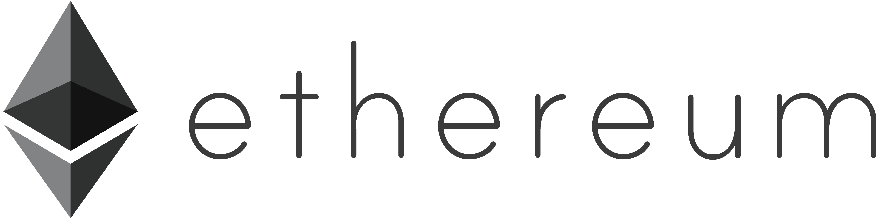


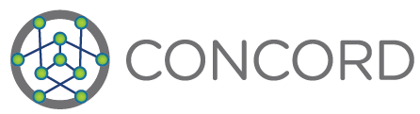
Types of Blockchains – Public, Private, & Consortium
Anyone can use a public blockchain network
E.g., Public Bitcoin, Public Ethereum, Public EOS
Public networks provide incentives for people to join & charge fees for use
Better transparency & auditability
Poor performance
Private blockchain is within a single organization
Consortium blockchain is used cross-organizations
Controlled by pre-authorized nodes
E.g., Hyperledeger, R3 Corda, VMware Concord
Consortium/private instantiation of public blockchain
Blockchain platform is (mostly) open source
Network layer access control – firewall
Notes:
BCs can be broadly classified as public, private, and consortium
Anyone can use a public BC network, and Bitcoin and Ethereum are the best examples
Public BC networks provide incentives for people to join, contribute computing power, and charge fees for use
While they have high transparency & auditability properties, they are poor in performance
A Private BC is used within a single organisation while a consortium BC is used cross-organisations. There is usually no difference in the technology used in each case.
Private or consortium BCs are gated where both the nodes in the network and users are pre-authorised.
Usually, they also don't use an explicit incentive mechanism like paying TX fees.
Some of the examples include Hyperledger, R3 Corda, and VMware Concord
BC platform software is usually open source. Thus, we also see many different instances of the same BC platform. For e.g., many public and private BC instances are based on Ethereum and EOS
Also, we see many examples of partial code reuse, for e.g., Ethereum style SCs are supported in Hyperledger and VMware Concord
When public BC platforms are used as private or consortium BCs, TXs fees could be ignored and access control could be provided via a firewall
We even see applications that use a mix of all 3 types of BCs

Slide 21
Types of Blockchains – Permissionless/Permissioned
Public blockchains are permissionless
Private/Consortium blockchains require permissions to access
More suitable for regulated industries → Know-Your-Customer (KYC)
Other permissions
Permission to initiate TXs
Permission to mine
Fine-grained permission: permission to create a particular asset
Public networks can be used for private purposes
E.g., executing an Ethereum smart contract to manage a supply chain
Require permissions to access the private portions
Notes:
Another classification of BCs is based on the permission for people to join, contribute computing power, and issue TXs
As anyone can use and contribute to a public BC they are considered as permissionless
Private or consortium BCs require permissions to access; hence, are more suitable for regulated industries
For example, in the finance industry, it is essential to Know-Your-Customers (KYC). Hence, an approval process is used before giving access to a BC
Other forms of permissions include:
Permission to initiate TXs
Permission to mine
Also fine-grained permissions such as permission to create a particular asset and execute a function in a SC
Public BC networks can also be used for private purposes by setting access rights through smart contracts.

Slide 22
Smart Contracts
Blockchain can deploy & execute programs called Smart Contracts
User-defined code, deployed on & executed by whole network
Can hold & transfer assets/states, managed by the contract itself
Can enact decisions on complex business conditions
Code is deterministic & immutable once deployed
Its execution is triggered via a TX
There is a cost to deploy & execute code
E.g., in Ethereum we pay per assembler-level instruction
Notes:
While BC was the foundation for cryptocurrencies like bitcoin, it has found much wider applications with the introduction of Smart Contracts (SCs)
SCs are essentially small user-defined code/programs/scripts deploy & execute on BC nodes
The code can hold & transfer assets/states, managed by the contract itself
The program logic can enact decisions on complex business conditions. For e.g., automatic partial payment can be triggered as a product moves along a supply chain
Due to immutability of a BC, smart contract code is deterministic & immutable once deployed
Execution of a SC is triggered via a TX
There is a cost to deploy & execute. For e.g., in Ethereum we pay per assembler-level instruction executed by a SC

Slide 23
Question
Which of the following statement(s) is True about blockchains?
Each node in a blockchain is trustable
The process of building a block is called mining
Permissions can't be used with public blockchains
A transaction can be altered by modifying only the block that contains the transaction
X
✓
X
X

Slide 24
Blockchain Applications
Notes:
Let's now talk a bit about various applications of BC

Slide 25
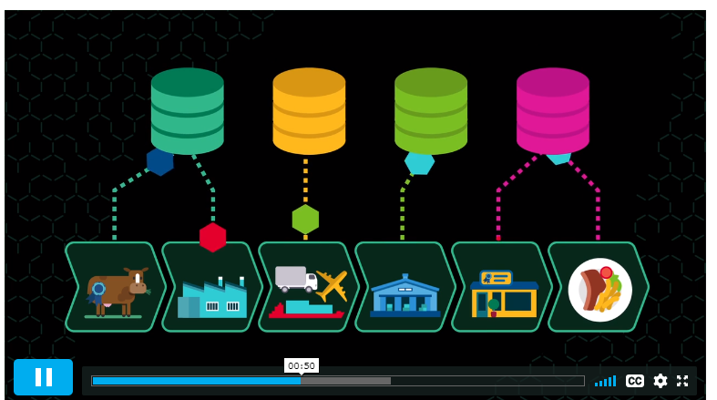
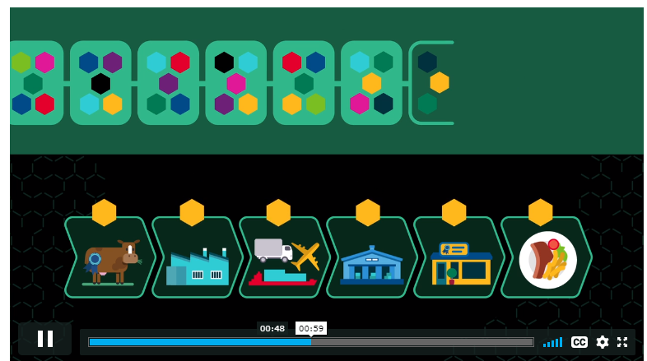
What is the Beef about Blockchain?
Video & reports:
https://www.data61.csiro.au/en/Our-Research/Focus-Areas/Distributed-Ledger-Technology-Blockchain
Notes:
https://www.data61.csiro.au/en/Our-Work/Safety-and-security/Secure-Systems-and-Platforms/Blockchain
Here is an example of how counterfeiting of Australian Beef can be overcome using BC technology

Slide 26
Application Areas – Financial Services
Digital currency
New form of money transferred without 3rd parties
Programmable money – Attach policies to specific parcels of currency
(International) payments
Via digital currency with local exchanges between digital currency & fiat currencies
Pseudonymous, but usually have regulatory requirements to have identity to prevent Anti-Money Laundering (AML)
Reconciliation for correspondent banking
Banks can create a single shared ledger of accounts maintained in real-time
Securities settlement
Exchanged assets are represented by tokens using smart contracts
Payment are made using tokens or native cryptocurrency
Markets
A platform for making & accepting offers to trade assets or services
Trade finance
Evidence trade-related documents & automate payments
26 |
COMP6452 Software Architecture for Blockchain Applications | Data61, CSIRO
Notes:
As BC was introduced for cryptocurrency, its design reflects many aspects of the finance industry.
Hence, it is a natural fit to other financial services such as Digital currencies, payments, banking, and financial markets.
For e.g., you could build programmable money by attaching policies on how they can be spent
It could also be used for cross-border payments by connecting with currency exchange to exchange between crypto and fiat currencies
Reconciliation and settlement in both banking and stock markets are another set of applications where money can be represented as digital tokens
As any asset, cryptocurrencies can be traded too
In these applications, a BC could handle the assets itself, as well as the regulatory controls, documentation, and audit needs
Digital currency is a new form of money. It can be implemented on blockchains. Digital currency can also serve as a foundation for incentive models that support data integrity for
many blockchain systems. Blockchains allow digital currency to be transferred between parties, often without those transfers being processed or recorded by banks or
payment services. With smart contracts, blockchains may be able to support “programmable money”. Some policies can be attached to specific parcels of currency.
(International) payments: can be done by blockchain, often via digital currency with local exchanges between the digital currency and fiat currencies. Public blockchain cryptocurrency payments are usually pseudonymous. For example on Bitcoin, transacting agents (which are not necessarily persons) are only identified with a cryptographic key. Therefore international exchange of the Bitcoin digital currency can be performed without establishing real-world identity, and we may not know which actual person is behind which account. But international payments usually have regulatory requirements to have the identity of participants, e.g. Anti-Money Laundering (AML) policies. It is often required that the transacting parties establish their real-world identities to each other.
Reconciliation for correspondent banking: Rather than conducting laborious end-of-day reconciliation as a batch task, the two banks can create a single shared view of truth
between their accounts, maintained in real time.
Securities settlement: The exchanged assets are typically represented by tokens implemented on the blockchain using smart contracts. Payments are sometimes made using such tokens or using the native cryptocurrency on the blockchain.
Markets: smart contracts on blockchains can provide a platform for making and accepting offers to trade assets or services. The blockchain will record the status of these trade offers. Individual smart contracts could carry the digital currency required to be paid on fulfilment of these offers. This functions as a kind of escrow, without the need for a trusted third-party organisation.
Trade finance: the blockchain can be used to evidence trade-related documents in order to reduce lending risk and improve access to finance for industry. Smart contracts
could control inter-organisational process execution and transparently automate instalment payments.

Slide 27
Application Areas – Enterprises & Industry
Supply chain – store key events to ensure goods provenance & logistic visibility
Utility resources & services – monitoring/metring & payment of usage
IoT - Device access control & software/configuration updates
Digital rights & IP management – A trusted media asset registry to store hashes, metadata, or other identifier on blockchain & manage access & right information
Data management – A metadata layer for decentralized & trustable data sharing & analytics
Proof of existence – Store a timestamped record of a hash of the document
Inter-divisional accounting – A shared distributed ledger of inter-divisional accounts
Corporate affairs – Board & shareholder registration & voting
27 |
COMP6452 Software Architecture for Blockchain Applications | Data61, CSIRO
Notes:
In addition to the financial services, supply chain is considered the next industry that could heavily benefit from the BC technology.
For e.g., a BC can be used to store key events along the supply chain to ensure goods provenance and logistic visibility
Other applications include utility & services, Internet of Things (IoT), Digital rights & Intellectual Property (IP) management.
These applications benefit from the ability to record and process data in a trusted and transparent platform.
These benefits could also extend to any application that requires data management, data sharing, proof of existence, and non-repudiation
Blockchains were first used for cryptocurrency, but are now being used for many other purposes. Here we list all the application areas for blockchain.
For supply chain, when we store key events on blockchain to ensure goods provenance, and improve logistic visibility and supply chain quality. Key events could also be linked to automatic payments using of smart contracts. That is called delivery vs. payment.
For IoT, blockchain can be used for device access control. It can also store information about IoT software and configuration updates and dynamically-delegated access.
Monitoring and payment for usage of utilities or services can be provided by using smart contracts and IoT devices.
Blockchain can provide a trusted registry for media asset or other IP. It can manage access and right information for media asset. Media assets are not necessarily stored on the blockchain. We can store their cryptographic hashes, meta-data and other identifiers stored on the blockchain and store the raw data off-chain.
A blockchain can create a metadata layer for decentralised data sharing and analytics. Although we cannot store large datasets themselves on blockchain, it can help to discover and integrate those datasets and data analytics services. Access control mechanisms implemented on a blockchain may allow public data sources to be integrated more easily with private data sets and analysis services.
Blockchain can be used to record evidence of the existence of data or documents, by creating a timestamped record of a cryptographic hash of the contents of those documents. This can be combined with records of the attestation or witnessing of corresponding physical documents by trusted third-parties.
Multi-national companies or large enterprises with separate divisional business units often have governance needs to control their own internal accounting, but also share accounting information with other divisions. A straightforward application of blockchain technologies on a shared private network can create a shared distributed ledger of inter-divisional
accounts at the interfaces between divisions.
Corporate affairs, like board and shareholder voting and registrations, the voting authorities of board members or shareholders in companies could be recorded and proxied on a blockchain. Smart contracts on blockchains could use that record to adjudicate votes conducted on the blockchain for specific motions. Cryptographic mechanisms may be required to prevent potentially undesirable strategic voting behaviours.

Slide 28
Application Areas – Government Services
Registries & identity
Including identities of persons, companies or devices; licensing; qualification; & certification
Grants & social security
Automate coordination process for application, decision making, & payment distribution
Allow conditional payments through programmable money – e.g., NDIS – where money checks the conditions for spending it when attempting to do so
Resource quota management
Government granted quotas, allocations, & rights to physical resources could be awarded & tracked through tokens
E.g. water access licenses can provide rights to take a certain volume of water from specific sources during specific time frames
Taxation
Automate tax collection using smart contract
28 |
COMP6452 Software Architecture for Blockchain Applications | Data61, CSIRO
Notes:
Government services include maintenance of various registries & identities of people and business
Grants & social security services could be handled through automation of processes and programmable money
Another application is the quota management. For e.g., the government grant quotas, allocations, & rights to resources such as water, areas and quantities for fishing or mining, and even the access to wireless spectrum for mobile operators
Taxation is another area that could provide better transparency for both the taxpayer and the government
Registries and identity, including the identities and attributes of persons, companies, or devices; licensing; qualifications; and certifications. Storing registry entries or cryptographic certification of registry entries on a blockchain can facilitate access to and validation against the register. Blockchains could be used to share authenticated identifiers for individuals and companies, and these identifiers could in turn also enable many other blockchain applications. Blockchains can support federated management of multiple related registries, by allowing different agencies to retain authoritative control over the contents of their registers, but still provide a shared view of truth about how their registers are inter-related.
Grants and social security: smart contracts could automate the process coordination to apply for, decide on, and distribute payments for grants and social security.
A smart contract could automatically limit payments to approved suppliers or categories of expenses. One early use of blockchain in this way was to account for allowances and payments by
refugees in a UN refugee camp.
Quota management: Government-granted quotas, allocations, and rights to physical resources could be awarded and tracked through tokens established on a blockchain.
Examples include water access licences providing rights to take a certain volume of water from specific sources during specific time frames
Taxation: automated collection of tax using smart contracts

Slide 29
Why Blockchain Architecture Design?
Notes:
Let get into the key theme of the course.
Why we want to look at BCs from a software architecture lense?

Slide 30
Overview
Many interesting applications for Blockchain
Basically of interest in most lack-of-trust settings where a distributed application can coordinate multiple parties
Examples:
Supply chains
Handling of titles, e.g., land, water, vehicles
... but also many challenges
When to use blockchain?
What blockchain platform to use?
Trade-offs in architecture
Downsides: cost, latency, confidentiality
Lack of quality of service guarantees & difficulty in correcting error
What to handle on-chain, what off-chain?
Notes:
While we see many exciting applications of BC, especially in lack-of-trust settings, BCs and applications that could benefit from them are quite complex.
As we'll explore more details around BCs, you will realise that it's nontrivial to answer some of the important questions like:
When to use BC?
What BC platform to use?
How to handle trade-offs in your solutions such as
Cost, latency, and confidentiality
Lack of quality of service guarantees & difficulty in correcting errors
What to handle on the BC, what to keep off the BC?
Therefore, in this course, we take a software architecture approach to design our BC-based applications to achieve the desired functional and non-functional requirements.
That'll help us answer these questions more objectively without being biased by so many unfounded claims around BC technologies.
You will also see that we pay greater emphasis on non-functional aspects, as they are important in architectural design to address trade-offs such as performance, quality of service, and cost

Slide 31
Properties of Blockchain
Blockchains are architectural design choice
Functionally, they are a kind of database & computational execution engine
Blockchain (non-functional) properties
(+) Integrity, Non-repudiation
(+ read/ - write) Availability
(+ read / - write) latency
(-) Confidentiality, Privacy
(-) Modifiability
(-) Throughput / Scalability / Big Data
Notes:
BCs are architectural design choices
In functionally, a BC could be considered as a form of a distributed database & computational platform with a set of properties
Some of these properties are encouraging while others are not.
(+) Integrity, Non-repudiation
(-) Modifiability
(+) Availability
(-) Confidentiality, Privacy
(+ read / - write) Latency
(-) Throughput
2 different BC platforms may satisfy these properties to different extents. For e.g., because permissioned BCs use access control, they have better confidentiality
We will revisit these properties through the course

Slide 32
Functions Blockchain can Provide in an Architecture
Architectural Element
Computational Element
Storage Element
Communi-cation Mechanism
Asset Management & Control Mechanism
Blockchain as…
Notes:
There are 4 key functions of a BC as an architectural element
Within an architecture of a software solution, a BC can be integrated as an element that provides storage and computation
It could also be used as a communication mechanism for multi-party interactions
Its storage and computation aspects can be combined to provide asset management and control mechanisms too

Slide 33


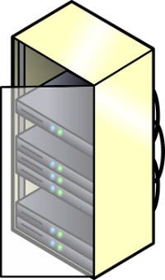


Blockchains aren’t Stand-Alone Systems
UI for humans
Legacy
systems
Key
management
BIG DATA
Blockchain is a component
IoT
integration
private
data
Auxiliary
databases
Notes:
BCs aren't stand-alone systems.
They need to be integrated with many other systems to be practically useful.
For e.g., some sort of a UI is needed for user interaction.
Also, cryptographic keys used to sign TXs need to be managed using a key management solution
BCs also need to integrate with external systems including legacy systems
For e.g., in a beef supply chain, we need to record the temperature experienced by beef during transport and storage using IoT integration.
Also, it will be part of a large data ecosystem for both storage and data analytics

Slide 34
How is Reality?
TX behavior is difficult to predict
TX failure difficult to detect
Mistakenly retry
Unauthorized termination of smart contract
＊7% smart contract can be terminated without authority (Public Ethereum)
Failure is permanent
Decentralized Autonomous Organization (DAO) code issue lead to USD 60 Million Ether theft during ICO (Initial Coin Offering)
Hard fork of Ethereum
Immature Code!
*I. Weber, V. Gramoli, M. Staples et al., “On availability for blockchain-based systems”, SRDS’17, Hong Kong, China, Sep. 2017.
Notes:
BCs have their caveats and the end result could be quite costly if proper design and controls are not in place
For e.g., TX behaviour is difficult to predict, and failures are difficult to detect
Unauthorised execution and termination of SCs is another problem. For e.g., 7% SC on Ethereum can be terminated without authority
Failure is permanent and there is no way of going back. For e.g., Decentralized Autonomous Organization (DAO) code issue lead to $60 Million Ether theft during ICO (Initial Coin Offering). While part of this money was recovered by changing the ledger state with a special mechanism called a Hard fork, it is unlikely to be done for an issued faced by a few users
Most of these issues are due to immature SC code. Hence, we also discuss these topics in detail in the course

Slide 35
Busting Blockchain Myths
Myth | Reality
Solves every problem | A kind of database with attached logic
Trustless | Can shift trust & spread trust
Secure | Focus is Integrity, not Confidentiality
Smart contracts are legal contracts | May help execute parts of some legal contracts
Immutable | Many only offer probabilistic immutability
Are inherently unscalable | Emerging blockchains are more scalable
Need to waste electricity | Emerging blockchains are more efficient
If beneficial, will be adopted | Adoption can be hampered by
Notes:
There is those who believe in BCs and those who don't. Most of this could be attributed to the involvement of cryptocurrencies and the negative publicity that they have gained
However, it is important that understand that BCs can function without cryptocurrencies, especially in enterprise applications
Here are some of the myths around BC
BC can't solve every problem. It is more of a databased and a computational engine to be used when there are concerns around trust
However, it is not completely trustless. Instead, it shifts and spreads trust to a set of node and code that govern the behaviour of those nodes
From the Confidentiality, Integrity, and Availability triad of security, focus is on integrity not confidentiality
SCs may help execute parts of some legal contracts but don't have same regal acceptance
As you will see later, immutability is probabilistic, which means it can change under very specific conditions
While it's true that public BCs are unscalable and waste electricity, emerging designs are far more scalable and efficient. For e.g., Ethereum 2.0
While BCs are certainly beneficial, adoption can be hampered by many non-technical factors

Slide 36
Relevant Topics in the Course
Architecting applications on Blockchain:
Taxonomy & design process
Blockchain as an element in an architecture
Functional & non-functional properties of blockchain
Blockchain Patterns
Trade-offs
Cost – how much will it cost to use blockchain?
Latency – uncertainties & quality of service
Security & Dependability
Model-driven development of smart contracts
Business process execution
Model-based generation of registries & UIs
Notes:
So in this course, we'll discuss more on architecting BC-based applications
We'll specifically focus on topics such as:
Terminology & design process
BC as an element or component in a software architecture
Functional & non-functional properties of BCs
Various design patterns related to BCs
As well as trade-offs such as cost, latency, and security
We also spend some time on model-driven development of smart contracts related to business process execution

Slide 37
Question
Mark True or False for each the following statements about a blockchain’s ability to handle data
 | True | False
Blockchains can store a large volume of data
Data can be read faster, but writing is slow
Data on a blockchain is secure
It’s impossible to correct errors in data
Both data & rules that govern the manipulation of that data can be specified in a smart contract
✓
✓
✓
✓
✓
Notes:
Before proceeding further, let's have another quick question on data on BCs

Slide 38
Problem Formulation
Notes:
The first step in trying to solve any problem is to understand the problem.
And it's the same when we adopt an architectural approach to solve a problem. So we need to understand the ins and outs of the problem we are trying to solve

Slide 39
Goal – Decentralized Trustless Environment
Organization 1
Organization 2
Organization 1
Organization 2
Centralized Trusted Authority
Blockchain network
Traditional trusted environment
Blockchain trustless environment
Notes:
Our objective is to replace the central authority with a decentralised solution based on a set of computers.
While this appear easy, let's discuss some requirements in replacing the authority and challenges we need to overcome in doing so

Slide 40
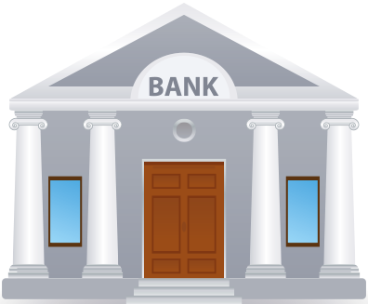



Decentralization of Ledger
ID
Assets
Alice
500
Bob
1,000
Charlie
500
Dave
Plot 123 @ 2015
ID
Assets
Sweet Mango
Bowen QUE, Org. Cert #45781
Alice
500
Bob
1,000
ID
Assets
Charlie
500
Alice
500
Dave
Plot 123 @ 2015
Bob
1,000
Sweet Mango
Bowen QUE, Org. Cert #45781
ID
Assets
Charlie
500
Alice
500
Dave
Plot 123 @ 2015
Bob
1,000
Sweet Mango
Bowen QUE, Org. Cert #45781
Charlie
500
Dave
Plot 123 @ 2015
Sweet Mango
Bowen QUE, Org. Cert #45781
Notes:
We are looking for a decentralised design by distributing the ledger maintained by the central authority
This sort of a design breaks its monopoly, enhances transparency, and avoids single point of failures
Each copy of the ledger is now managed by a different party

Slide 41
Replicated vs. Distributed Ledger
ID
Assets
Alice
500
ID
Assets
Bob
1,000
Bob
1,000
Charlie
500
Charlie
500
Dave
Plot 123 @ 2015
Dave
Plot 123 @ 2015
ID
Assets
Sweet Mango
Bowen QUE, Org. Cert #45781
Alice
500
Bob
1,000
ID
Assets
Charlie
500
Alice
500
ID
Assets
Dave
Plot 123 @ 2015
Bob
1,000
Alice
500
Sweet Mango
Bowen QUE, Org. Cert #45781
ID
Assets
Dave
Plot 123 @ 2015
Bob
1,000
Alice
500
Sweet Mango
Bowen QUE, Org. Cert #45781
Charlie
500
Charlie
500
Dave
Plot 123 @ 2015
Sweet Mango
Bowen QUE, Org. Cert #45781
Sweet Mango
Bowen QUE, Org. Cert #45781
Notes:
We also have a choice of whether we want to have a fully replicated or distributed ledger
On the left, we have a fully replicated ledger where 3 parties maintain the same data while on the right, we keep only 2 copies of the same piece of data
While design on left leads to a very robust solution against failure, it's is costly to maintain and reduces the write performance. For e.g., today, Bitcoin ledger is about 200 GB while Ethereum ledger is around 700 GB.
While most contemporary BCs adopt full replication, BC such as R3 Corda and BigchainDB adopt a decentralised design. However, this is changing. For e.g., Ethereum 2.0 is expected to reflect a distributed design

Slide 42

Keeping Ledger Consistent
B
Transfer 300 to Bob
ID
Assets
A
Alice
200 500
ID
Assets
Bob
1,300 1,000
Alice
500
Charlie
500
Transfer 300 to Bob
Bob
1,000
Charlie
500
C
Alice may initiate request from her node or any other node
No of messages increase with no of ledger copies
ID
Assets
Alice
200 500
Bob
1,300 1,000
Charlie
500
Notes:
Whether it's a replicated vs. distributed ledger, as soon as you have more than one copy, we need to worry about keeping the ledger consistent
Suppose we keep 3 copies of the ledger and Alice wants to transfer $300 to Bob
Ideally, this should be recorded on all 3 copies where $300 deducted from Alice and added to Bob's account
This can be achieved using message passing and the number of messages needed increases with the number of ledger copies

Slide 43
Network Partitioning
B
Transfer 300 to Bob
ID
Assets
A
Alice
200 500
ID
Assets
Bob
1,300 1,000
Alice
500
Charlie
500
Transfer 300 to Bob
Bob
1,000
Charlie
500
C
Likeliness of failure increases with no of ledger copies
ID
Assets
Alice
500
Bob
1,000
Charlie
500
Notes:
Unfortunately, networks are unreliable. Hence, while Alice message may reach node B, it may not reach node C leading to an inconsistent ledger
This problem worsens when there are many copies of ledger as more messages are needed and a few of them may get dropped
While a temporary inconsistency maybe ok, as far as we can reconcile later once the message is received, this could lead other problems

Slide 44
Double Spending Problem
B
Transfer 300 to Bob
ID
Assets
A
Alice
200 500
ID
Assets
Bob
1,300 1,000
Alice
500
Charlie
500
Bob
1,000
Transfer 400 to Charlie
Charlie
500
C
Likeliness of attack increases with no of ledger copies
ID
Assets
Alice
100 500
Bob
1,000
Charlie
900 500
Notes:
For e.g., Alice may benefit from temporary inconsistency to double spend her money.
For e.g., while Alice transfers $300 to Bob she also transfers $400 to Charlie to buy a bicycle.
Even through Alice doesn't have enough money for both TXs, ledger copies will accept each TX, as per their copy of ledger Alice has enough money.
While the inconsistency will be eventually detected and one or both TXs could be reverted, Charlie may have also shipped the bicycle Alice ordered
Like the network problem, likeliness of double spending attacks increases with no of ledger copies

Slide 45
Concurrent Transactions
t = 13
t = 15
B
Transfer 300 to Bob
t = 10
ID
Assets
A
Transfer 1200 to Charlie
t = 18
Accept
Alice
200 500
ID
Assets
Bob
1,300 1,000
Alice
200 500
Charlie
500
Transfer 300 to Bob
Transfer 1200 to Charlie
Bob
1,300 1,000
t = 16
Charlie
500
Reject
t = 18
C
Inconsistent ledger due to concurrent TXs
Inconsistency increases with no of ledger copies
ID
Assets
Alice
500
Bob
1,000
Charlie
500
Notes:
Another case that can go wrong is when TXs are concurrent
Based on Alice TXs to transfer $300 to Bob, Bob issue another TX to transfer $1,200 to Charlie.
However, due to varying network delays across nodes, C may receive Bob's TX before Alice's TX.
In that case, it will reject Bob's TXs leading to an inconsistent ledger

Slide 46
Question
What are some potential solutions to overcome consistency issues we came across so far?
Keep only a single copy of an account/record
Get a confirmation/Ack from all the replicas before updating an account
Wait sometime for a TX to complete
Nodes to periodically double check each others state
Not shipping the bicycle immediately
Complete one TX on all nodes before allowing another TX on a related account
Order TXs based on sender’s time
….
No concurrent TXs
Use time to decide on an action
Notes:
Can you think about several potential solutions to overcome consistency issues we came across so far?
While we can think of many solutions, most of them are related to ideas like the following
Most likely these ideas are centred around either preventing concurrency or relay on some notion of time such as wait for some time or rely on sender's time

Slide 47
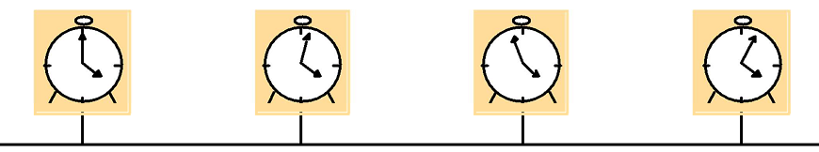
Timing & Ordering
Use of sender’s time to order TXs not reliable
Clocks aren’t accurate – Drift & skew
Difficult to sync them & keep them synched
Sender could change time to game the system
Physical time isn’t a reliable measure in distributed systems
We need nodes/replicas to agree on a global ordering of TXs
Notes:
Unfortunately, time on a distributed system is not a reliable measure
Some clocks are fast, some are slow, and even if you sync them, they lose the synchronisation after a while
Difference in the rate that clocks tics is called the clock Drift
Whereas difference in time of set of clocks is called the clock Skew
Also, if we use time, Alice could also manipulate timestamp she attaches to each TX leading to further chaos
Essentially, physical time isn't a reliable measure in distributed systems
However, if we look at what we really need is for the nodes/replicas to agree on a global ordering of TXs

Slide 48
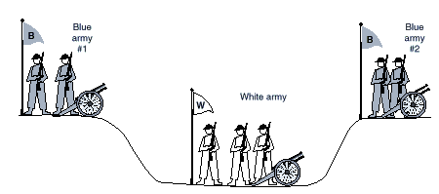
2-Army Problem
Source: www.ee.surrey.ac.uk/Projects/CAL/ networks/ Network-ransport_Application_Layers.htm
2 Blue armies need to simultaneously attack or retreat
Blue army have to communicate across area controlled by White army
White army area → Unreliable communication channel
Goal – 2 blue armies to reach agreement about attacking
Notes:
So let's talk about agreement in a distributed system
This is called the 2-Army problem which is a simplified from of the "Byzantine general" problem in Computer Science
While the Blue army is outnumbered, it's fragmented. Hence, 2 Blue armies need to simultaneously attack or retreat
Blue army must communicate across the area controlled by the White army. We could think of this as an unreliable network where the messenger may get delayed or lost
Given the unreliable channel we still need the 2 blue armies to reach agreement about attacking

Slide 49


Gotcha, I lied
2-Army Problem – Communication
I have a plan – Let’s attack at dawn tomorrow
Blue left
Splendid idea, A! See you at dawn tomorrow!
Blue right
Received message. We are ready for the battle.
Received acknowledgement. We are also ready
Notes:
Suppose the general on left send a messenger with his plan to attack
One the message reaches the general on the right, he needs to confirm that he got the message and ready to attack
So send an Ack. Suppose the messenger managed to get through
While the general on left is happy about the plan and prepare for the battle, general on the right doesn't know whether the messenger got through the White army-controlled area
If he doubts and doesn't attack all is over. Hence, the general on left decide to send another Ack
However, now the general on the left doesn't know whether the Ack to the Ack got through. So if he hesitates, the batter is over
I guess you get the point that 2 generals can continue to Ack each other without being certain on their decision
So the moral of the store is, in the presence of an unreliable channel, it is impossible to reach an agreement
Also, one of the general maybe corrupt and may mislead the other. This is another challenge that a BC network needs to address as not all nodes are honest

Slide 50
Consensus
Agreement in the judgment or opinion reached by a group as a whole
Getting 2 nodes to agree is hard
Getting many nodes to agree is even harder
Achieving consensus under:
Unreliable communication – Partition tolerance
Failed nodes – Fault tolerance
Misbehaving nodes – Byzantine fault tolerance
Notes:
Agreement in the judgment or opinion reached by a group is referred to as consensus
We already saw that getting 2 nodes to agree is hard. And this just gets worse as we add more nodes into the equation
Hence, achieving consensus on the order of TXs and state in a distributed ledger is extremely difficult in the presence of:
Unreliable communication. Ability to tolerate such issues is called Partition tolerance
Fault tolerance is needed to handle Failed nodes
Misbehaving nodes need more complicated solutions such as Byzantine fault tolerance

Slide 51
CAP Theorem
“It’s impossible for a web service to provide following 3 guarantees at the same time” (Eric Brewer, 2000)
Consistency
Availability
Partition-tolerance
ID
Assets
ID
Assets
Alice
500
Alice
500
Bob
1,300 1,000
Bob
1,300 1,000
Charlie
200 500
Charlie
200 500
A
Charlie = 500
B
Charlie = 200
Transfer 300 to Bob
Notes:
Another concept related to unreliable communication is the CAP theorem
In 2000, Dr. Brewer said that "It’s impossible for a web service to provide guarantees on consistency, availability, and partition tolerance at the same time”
This eventually became a theorem and was formally proved a year later
Let me illustrate the idea using an example.
Charlie transfers $300 to Bob and sends the message to replica B. Which is expected to update replica A.
So if Charlie queries A, he should get a balance of $200.
However, if the network is partitioned such that replicas A & B can’t talk to each other, when Charli queries replica A it’ll get an inconsistent result
So we can see that while the distributed ledger is available for reading and writing and network is partitioned, ledger state is not consistent
Only way to keep the ledger consistent during network partition is to stop updating the ledger. Which means the availability is affected

Slide 52
CAP Theorem (Cont.)
C
A
Nodes loose network connectivity
Networks will partition!
Partition tolerance is mandatory in distributed systems
So, choose Consistency or Availability…
Blockchain needs to be Available
Ledger needs to be Consistent
Consensus → Consistency
P
Notes:
Partition tolerance is not really a choice, as nodes loose network connectivity occasionally
Hence, partition tolerance is mandatory in distributed systems.
So, choose is either to compromise consistency or availability
As discussed so far, BC needs to be available and the ledger needs to be consistent. Consistency is achieved by consensus which we also discussed as very difficult
So we are asking for 2 conflicting and difficult properties

Slide 53
Blockchain Design
Blockchain presents a unique design such that we can achieve a decentralized trustless environment with
decentralised & consistent ledger
ability to prevent double spending
high availability
while overcoming
unreliable networks
timing & ordering issues
faulty & misbehaving nodes
Of course, there are some trade-offs in achieving these
Notes:
So the beauty of the BC design is that it presents a unique design such that we can achieve a decentralised, trustless environment with
decentralised & consistent ledger
the ability to prevent double spending
the ability to perform concurrent TXs
with high availability
while overcoming issues such as
unreliable networks
unreliable clocks
faulty nodes
misbehaving nodes
Of course, as we’ll discuss in next lecturer, there are some trade-offs in achieving this

Slide 54
Course Outline – Next 2 Weeks
Week | Date | Lecturer | Lecture Topic | Relevant Book Chapters | Notes
1 |  | Dilum | Blockchain platforms | Existing Blockchain Platforms Varieties of blockchain | Project 1 out
2 |  | Sherry | Blockchain in software architecture Blockchain taxonomy | 5. Blockchain in Software Architecture
3 |  | Sherry | Blockchain taxonomy Guest lecture |  | Project 1 submission Project 2 release
Note: Tutorials run from week 1 to week 9.
They aren‘t mandatory, but very helpful, especially for completing the projects.
Notes:
Next, a bit of housekeeping
See you in the next class where we’ll be talking about Bitcoin, Ethereum, and Hyperledeger

